Slide 1
George
Uber Eat driver
Notes:
mesassi@microsoft.com
425-435-8370

Slide 2

George
or a single dad
Notes:
mesassi@microsoft.com
425-435-8370

Slide 3
George
Came to Year Up
Notes:
mesassi@microsoft.com
425-435-8370

Slide 4
George
got his first interview
Notes:
mesassi@microsoft.com
425-435-8370

Slide 5

George
got his first interview and… failed
Notes:
mesassi@microsoft.com
425-435-8370

Slide 6
George
wonders why…
What he can do now
cry
ask employers for feedback
look up online
talk to friends
seek advice from advisor
…
Notes:
mesassi@microsoft.com
425-435-8370

Slide 7
or
George
can use a tool
Notes:
mesassi@microsoft.com
425-435-8370

Slide 8
or
George
can use a tool
Notes:
mesassi@microsoft.com
425-435-8370

Slide 9

Software Engineer
I want to be a
QA Tester
IT Help Desk
Teller
Desktop Support Technician

Slide 10
IT Help Desk
I want to be a
QA Tester
IT Help Desk
Teller
Desktop Support Technician

Slide 11
Quality Assurance
I want to be a
QA Tester
IT Help Desk
Teller
Desktop Support Technician

Slide 12
Software Engineer
I want to be a
QA Tester
IT Help Desk
Teller
Desktop Support Technician
S

Slide 13
Software Engineer
I want to be a
Software Engineer
Software Tester
Senior Teller
Senior Program Manager

Slide 14
Software Engineer
I want to be a
Software Engineer
Software Tester
Senior Teller
Senior Program Manager

Slide 15
Software Engineer
I want to be a
Software Engineer
Software Tester
Senior Teller
Senior Program Manager

Slide 16
Software Engineer
I want to be a
Software Engineer
Software Tester
Senior Teller
Senior Program Manager

Slide 17
Software Engineer
I want to be a
Now, I know
Java
C++
JavaScript
Go
C
Fool
I’m done

Slide 18
Software Engineer
I want to be a
Now, I know
Java
C++
JavaScript
Go
C
Fool
I’m done

Slide 19
Software Engineer
I want to be a
Now, I know
Java
C++
JavaScript
Go
C
Fool
I’m done

Slide 20
Software Engineer
I want to be a
Now, I know
Java
C++
JavaScript
Go
C
Fool
I’m done

Slide 21
Software Engineer
I want to be a
Now, I know
Java
C++
JavaScript
Go
C
Fool
I’m done

Slide 22
Software Engineer
I want to be a
Now, I know
Java
C++
JavaScript
Go
C
Fool
I’m done

Slide 23
Software Engineer
I want to be a
Now, I know
Java
C++
JavaScript
Go
C
Fool
I’m done

Slide 24
Software Engineer
I want to be a
Now, I know
Java
C++
JavaScript
Go
C
Fool
I’m done

Slide 25
Software Engineer
I want to be a
So I need to learn
C++
Go
C
Hold on… Preparing your study path…
Edit my selection

Slide 26
C++
C++ Basic at Year Up
Power up C++ with the Standard Template Library
Introduction to C++
C++ Programming
Go
A Tour of Go - The Go Programming Language
Go Programming in One Week
Introduction to Go Programming Language
Learn GoLang
C
C Programming
Learn C
Teach Yourself C in 24 Hours
C Programming For Beginners
I am now a 50% Software Engineer

Slide 27




C++
C++ Basic at Year Up
Power up C++ with the Standard Template Library
Introduction to C++
C++ Programming
Go
A Tour of Go - The Go Programming Language
Go Programming in One Week
Introduction to Go Programming Language
Learn GoLang
C
C Programming
Learn C
Teach Yourself C in 24 Hours
C Programming For Beginners
I am now a 50% Software Engineer

Slide 28




C++
C++ Basic at Year Up
Power up C++ with the Standard Template Library
Introduction to C++
C++ Programming
Go
A Tour of Go - The Go Programming Language
Go Programming in One Week
Introduction to Go Programming Language
Learn GoLang
C
C Programming
Learn C
Teach Yourself C in 24 Hours
C Programming For Beginners
I am now a 50% Software Engineer

Slide 29
C++
C++ Basic at Year Up
Power up C++ with the Standard Template Library
Introduction to C++
C++ Programming
Go
A Tour of Go - The Go Programming Language
Go Programming in One Week
Introduction to Go Programming Language
Learn GoLang
4.3★ · FREE · 1wk
C
C Programming
Learn C
Teach Yourself C in 24 Hours
C Programming For Beginners
I am now a 50% Software Engineer

Slide 30
C++
C++ Basic at Year Up
Power up C++ with the Standard Template Library
Introduction to C++
C++ Programming
Go
A Tour of Go - The Go Programming…
Go Programming in One Week
Introduction to Go Programming Language
Learn GoLang
4.9★ · FREE
C
C Programming
Learn C
Teach Yourself C in 24 Hours
C Programming For Beginners
I am now a 50% Software Engineer

Slide 31
C++
C++ Basic at Year Up
Power up C++ with the Standard Template Library
Introduction to C++
C++ Programming
A Tour of Go - The Go Programming Language
4.9★ · FREE
Go
Go Programming in One Week
Introduction to Go Programming Language
Learn GoLang
”Amazing level of detail, reference material, links. By far the best resource for learning Go I have come across.”
Recommended to you by Year Up 2015 Alumni, Software Engineer at Google, Ashley Smith
C
C Programming
Learn C
Teach Yourself C in 24 Hours
C Programming For Beginners
Start
I am now a 50% Software Engineer

Slide 32
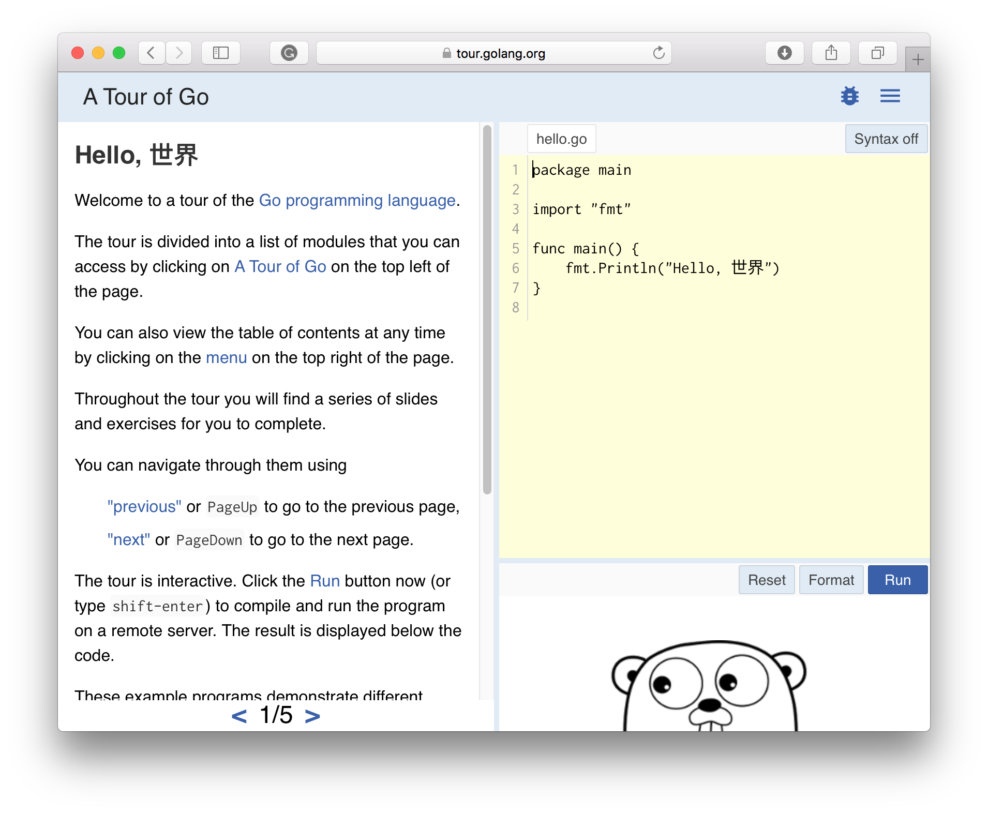
C++
C++ Basic at Year Up
Power up C++ with the Standard Template Library
Introduction to C++
C++ Programming
A Tour of Go - The Go Programming Language
4.9★ · FREE
Go
Go Programming in One Week
Introduction to Go Programming Language
Learn GoLang
”Amazing level of detail, reference material, links. By far the best resource for learning Go I have come across.”
Recommended to you by Year Up 2015 Alumni, Software Engineer at Google, Ashley Smith
C
C Programming
Learn C
Teach Yourself C in 24 Hours
C Programming For Beginners
Go
I am now a 50% Software Engineer

Slide 33
C++
C++ Basic at Year Up
Power up C++ with the Standard Template Library
Introduction to C++
C++ Programming
Go
A Tour of Go - The Go Programming Language
Go Programming in One Week
Introduction to Go Programming Language
Learn GoLang
In Progress
C
C Programming
Learn C
Teach Yourself C in 24 Hours
C Programming For Beginners
I am now a 50% Software Engineer

Slide 34
C++
C++ Basic at Year Up
Power up C++ with the Standard Template Library
Introduction to C++
C++ Programming
Go
A Tour of Go - The Go Programming Language
Go Programming in One Week
Introduction to Go Programming Language
Learn GoLang
In Progress
C
C Programming
Learn C
Teach Yourself C in 24 Hours
C Programming For Beginners
I am now a 50% Software Engineer

Slide 35
C++
C++ Basic at Year Up
Power up C++ with the Standard Template Library
Introduction to C++
C++ Programming
Go
A Tour of Go - The Go Programming Language
Go Programming in One Week
Introduction to Go Programming Language
Learn GoLang
In Progress
C
C Programming
Learn C
Teach Yourself C in 24 Hours
C Programming For Beginners
I am now a 50% Software Engineer

Slide 36
C++
C++ Basic at Year Up
Power up C++ with the Standard Template Library
Introduction to C++
C++ Programming
A Tour of Go - The Go Programming Language
Go to course
Mark as done
Abandon
Go
Go Programming in One Week
Introduction to Go Programming Language
Learn GoLang
C
C Programming
Learn C
Teach Yourself C in 24 Hours
C Programming For Beginners
In progress since yesterday
I am now a 50% Software Engineer

Slide 37
C++
C++ Basic at Year Up
Power up C++ with the Standard Template Library
Introduction to C++
C++ Programming
Go
A Tour of Go - The Go Programming Language
Go Programming in One Week
Introduction to Go Programming Language
Learn GoLang
C
C Programming
Learn C
Teach Yourself C in 24 Hours
C Programming For Beginners
I am now a 50% Software Engineer

Slide 38
C++
C++ Basic at Year Up
Power up C++ with the Standard Template Library
Introduction to C++
C++ Programming
A Tour of Go - The Go Programming Language
Go
Go Programming in One Week
Introduction to Go Programming Language
Learn GoLang
C
C Programming
Learn C
Teach Yourself C in 24 Hours
C Programming For Beginners
I am now a 50% Software Engineer

Slide 39
C++
C++ Basic at Year Up
Power up C++ with the Standard Template Library
Introduction to C++
C++ Programming
A Tour of Go - The Go Programming Language
Go
Go Programming in One Week
Introduction to Go Programming Language
Learn GoLang
C
C Programming
Learn C
Teach Yourself C in 24 Hours
C Programming For Beginners
I am now a 50% Software Engineer

Slide 40
C++
C++ Basic at Year Up
Power up C++ with the Standard Template Library
Introduction to C++
C++ Programming
Go Programming in One Week
Introduction to Go Programming Language
Learn GoLang
C
C Programming
Learn C
Teach Yourself C in 24 Hours
C Programming For Beginners
Go
I am now a 50% Software Engineer

Slide 41
C++
C++ Basic at Year Up
Power up C++ with the Standard Template Library
Introduction to C++
C++ Programming
C
C Programming
Learn C
Teach Yourself C in 24 Hours
C Programming For Beginners
Go
I am now a 67% Software Engineer

Slide 42
C++
C++ Basic at Year Up
Power up C++ with the Standard Template Library
Introduction to C++
C++ Programming
C
C Programming
Learn C
Teach Yourself C in 24 Hours
C Programming For Beginners
I am now a 67% Software Engineer

Slide 43
Communicating Strategically
Communicating Strategically
Communicating Strategically
4.1★ · FREE · 3wk
I am now a 50% Software Engineer

